Slide 1
Radar Clutter Modeling and Analysis
EGO Workshop 2012 - October 15-17, 2012 – Cascina
Maria S. Greco, Fulvio Gini
Dept. of Ingegneria dell’Informazione
University of Pisa
Via G. Caruso 16, I-56122, Pisa, Italy
m.greco@iet.unipi.it

Slide 2
Outline of the talk
Introduction
Gaussian model and RCS
Compound-Gaussian model
Spectral modeling
Clutter analysis and model validation
Concluding remarks
EGO Workshop 2012 - October 15-17, 2012 – Cascina

Slide 3
Outline of the talk
Introduction
Gaussian model and RCS
Compound-Gaussian model
Spectral modeling
Clutter analysis and model validation
Concluding remarks
EGO Workshop 2012 - October 15-17, 2012 – Cascina

Slide 4
Radar systems detect targets by examining reflected energy, or returns, from objects
Along with target echoes, returns come from the sea surface, land masses, buildings, rainstorms, and other sources
Much of this clutter is far stronger than signals received from targets of interest
The main challenge to radar systems is discriminating these weaker target echoes from clutter
Coherent signal processing techniques are used to this end
Courtesy of SELEX S.I.
The IEEE Standard Radar Definitions (Std 686-1990) defines coherent signal processing as echo integration, filtering, or detection using the amplitude of the received signals and its phase referred to that of a reference oscillator or to the transmitted signal.

Slide 5
Scheme of a typical ground-based surveillance radar
*
* In a modern digital coherent processor, the phase and amplitude information is preserved by digitizing two quadrature video channels.

Slide 6
Pulse Doppler Data Collection
LMN samples per CPI

Slide 7
Radar Data “Cube”
Let z_{nml} be the complex sample from the nth element, mth pulse, at the lth sample time (range gate).
Let z_{ml} be the Nx1 vector of antenna element outputs, or a spatial snapshot, at the time of the lth range gate and mth pulse.
Then, the NxM matrix Z_{l} consist of the spatial snapshots for all pulses at the range of interest, or the cell under test (CUT).
The rows of Z_{l} represent the temporal (pulse-by-pulse) samples for each antenna element. Beamforming (spatial filtering) is an operation that processes the columns of Z_{l}, while processing the rows is a temporal (or Doppler) filtering operation.

Slide 8
Radar Data “Cube”

Slide 9
Radar Detection Problem
The radar scenario involves a transmitter and a receiver, at the same location (monostatic configuration), equipped with an array of sensors, a target at a certain “distance” from the array (range) in the far zone, and a narrowband signal that travels the round-trip between the radar and the target.
The received signals will always contain a component due to receiver noise and may contain components due to both desired targets and undesired interference (jamming and clutter).

Slide 10
What is the clutter?
Clutter refers to radio frequency (RF) echoes returned from targets which are uninteresting to the radar operators and interfere with the observation of useful signals.
Such targets include natural objects such as ground, sea, precipitations (rain, snow or hail), sand storms, animals (especially birds), atmospheric turbulence, and other atmospheric effects, such as ionosphere reflections and meteor trails.
Clutter may also be returned from man-made objects such as buildings and, intentionally, by radar countermeasures such as chaff.

Slide 11
Radar clutter
Radar clutter is defined as unwanted echoes, typically from the ground, sea, rain or other atmospheric phenomena.
These unwanted returns may affect the radar performance and can even obscure the target of interest.
Hence clutter returns must be taken into account in designing a radar system.
Towards this goal, a clutter model assumption is necessary!
The function of the clutter model is to define a consistent theory whereby a physical model results in an analytical model which can be used for radar design and performance analysis.

Slide 12
Outline of the talk
Introduction
Gaussian model and RCS
Compound-Gaussian model
Spectral modeling
Clutter analysis and model validation
Concluding remarks
EGO Workshop 2012 - October 15-17, 2012 – Cascina

Slide 13
Clutter reflectivity
A perfectly smooth and flat conducting surface acts as a mirror, producing a coherent forward reflection, with the angle of incidence equal to the angle of reflection. If the surface has some roughness, the forward scatter component is reduced by diffuse, non-coherent scattering in other directions.
For monostatic radar, clutter is the diffuse backscatter in the direction towards the radar

Slide 14
The Gaussian model
The scattered clutter can be written as the vector sum from N random scatterers
phase term
RCS of a single scatterer
With low resolution radars, N is deterministic and very high in each illuminated cell. Through the application of the central limit theorem (CLT) the clutter returns z can be considered as Gaussian distributed, the amplitude r =|z| is Rayleigh distributed and the most important characteristic is the radar cross section (RCS).

Slide 15
Radar Cross Section (RCS)
The IEEE Standard for RCS in square meters is
where
P_{s} = power (watts) scattered in a specified direction from the target having RCS σ
Ω = solid angle (steradians) over which P_{s} is scattered
p_{i} = power density (watts/m²) of plane wave at target

Slide 16
Range of RCS Values (dBm²)
Radar Cross Section (RCS)
Echo power directly proportional to RCS
Factors that influence RCS:
size, shape, material composition, moisture content, surface coating and roughness, orientation, polarization, wavelength, multipath
RCS of common objects

Slide 17
Normalized RCS σ⁰
The normalized clutter reflectivity, σ₀, is defined as the total RCS, σ, of the scatterers in the illuminated patch, normalized by the area, A_{c}, of the patch and it is measured in units of dBm²/m².
range resolution
local grazing angle
The factor α accounts for the actual compressed pulse shape and the azimuth beamshape

Slide 18
Volume reflectivity η
The volume clutter reflectivity, η, is defined as the total RCS, σ, of the scatterers in the illuminated volume, normalized by the volume itself, V_{c}, and it is measured in units of dBm²/m³.
one-way 3dB elevation beamwidth

Slide 19
Radar Equation and propagation factor F
For monostatic radar, received power P_{r} from a target with RCS σ is
P_{t} = transmit power
G = antenna gain
R = distance of target from antenna
F = the pattern-propagation factor, the ratio of field strength at a point to that which would be present if free-space propagation had occurred
A clutter measurement provides either σF⁴ or σºF⁴.
Even so, normally the data are reported as being σ or σº.

Slide 20
Discrete and distributed clutter
DISCRETE
RCS depends on aspect angle, multipath environment, frequency, and polarization
RCS values up to 30 dBm² are common
RCS above 40 dBm² rare, except in built-up areas
Nominal RCS values:
60 dBm² very large ship or building
50/40 dBm² large building or ship
30/20 dBm² small building/house
20/10 dBm² trucks/automobiles
DISTRIBUTED
Average RCS = sº times A, where A is illuminated surface area (footprint) of a range-azimuth cell

Slide 21
Sea clutter: Dependence on grazing angle
At near vertical incidence, the backscatter is quasi-specular and varies inversely with surface roughness with a maximum at vertical incidence for a perfectly smooth surface.
At medium grazing angles the reflectivity shows a lower dependence on grazing angle (plateau region).
Below some critical angle
(~ 10º, depending on the roughness) the reflectivity reduces rapidly with smaller grazing angles (interference region, where propagation is strongly affected by multipath scattering and shadowing).

Slide 22
Empirical model for sea clutter σ⁰
Nathanson tables [Nat69]
The "standard" beginning 1969, updated 1990
HH and VV POLs; 0.1°, 0.3°,1°, 3°, 10°, 30°, 60° grazing
Many data sources, 60 different experiments
UHF to millimeter wavelengths
Reported by sea state up to state 6
Averaged without separating by wind or wave direction
Greatest uncertainties at lower frequencies and < 3°
Reported RCS generally larger than typical because
(a) experimenters tend to report strongest clutter and
(b) over-water ducting enhances apparent RCS
[Nat69] F.E. Nathanson, Radar Design Principles, McGraw Hill, 1969

Slide 23
Empirical model for sea clutter σ⁰
GIT model [Hor78]
Variables: radar wavelength, grazing angle, wind speed, wind direction from antenna boresight, wave height
Employs separate equations: for HH and VV polarization, and for 1 to 10 GHz and 10 to 100 GHz
The 1-10 GHz model based on data available for grazing angles of 0.1 to 10º and average wave heights up to 4 m (corresponds to significant wave heights of 6.3 m)
Few liable σºF⁴ data available at 3º grazing and below,
and for dependencies on wind and wave directions
Graphs from the model appear to give “best guesses” of σºF⁴ versus grazing angles less than 10º
[Hor78] M.M. Horst, F.B. Dyer, M.T. Tuley, “Radar Sea Clutter Model”, IEEE International Conf. Antennas and Propagation, Nov. 1978, pp 6-10.

Slide 24
Empirical model for sea clutter σ⁰
GIT model: Wind speed dependence
HH POL, 10 GHz
Cross-wave direction,
2 m signif. wave height, winds 3, 5, 10, 20 m/s
σºF⁴ increases with wind speed
Critical angle unchanged, because wave height assumed fixed.

Slide 25
Empirical model for sea clutter σ⁰
GIT model: Dependence on significant wave height h_{1/3}
HH POL, 10 GHz
Cross-wave direction,
10 m/s wind speed,
h1/3 = 0.5, 2, and 6 m
In plateau region, σºF⁴ is independent of h_{1/3} (for fixed wind speed)
σºF⁴ increases with h_{1/3} (multipath reduces critical angle) at angles < 1º

Slide 26
Empirical model for sea clutter σ⁰
GIT model: Comparison between HH and VV POL, 10 GHz
Wind speed/wave height in equilibrium
σºF⁴ increases with wind speed and h_{1/3}
HH/VV ratio increases with increased surface roughness and reduced grazing angle
HH>VV at small angles under rough conditions at 1.25 and 10 GHz

Slide 27
σº vs incidence angle for rough ground [Ula89]
Empirical model for land clutter σ⁰
4.25 GHz data, high moisture content
σº is insensitive to surface roughness at 10º (80º grazing)
Same insensitivity to roughness observed at 80º grazing in 1.1 GHz and 7.25 GHz data
Same shapes but lower σº for dry conditions
[Ula89] Ulaby, F.T. and Dobson, M.C, Handbook of Radar Scattering Statistics for Terrain, Artech House, Norwood MA, 1989

Slide 28
Land clutter σ⁰ at low grazing angles
37 Rural Sites [Bil02]
Spatial averages of σºF⁴ for θ < 8º grazing
Larger spreads in σºF⁴ at lower frequencies
Resolution 150 & 15/36 m
HH and VV polarizations
At each frequency, the median spatial average is roughly –30 dB
Note: σºF⁴ can be larger at the lower frequencies
[Bil02] J.B. Billingsley, Low-angle radar land clutter – Measurements and empirical models, William Andrew Publishing ,Norwich, NY, 2002.

Slide 29
Radar clutter modeling
In the quest for better performance, the resolution capabilities of radar systems have been improved
For detection performance, the belief originally was that a higher resolution radar system would intercept less clutter than a lower resolution system, thereby increasing detection performance
However, as resolution has increased, the clutter statistics have no longer been observed to be Gaussian, and the detection performance has not improved directly
The radar system is now plagued by target-like “spikes” that give rise to non-Gaussian observations
These spikes are passed by the detector as targets at a much higher false alarm rate (FAR) than the system is designed to tolerate
The reason for the poor performance can be traced to the fact that the traditional radar detector is designed to operate against Gaussian noise
New clutter models and new detection strategies are required to reduce the effects of the spikes and to improve detection performance
EGO Workshop 2012 - October 15-17, 2012 – Cascina

Slide 30
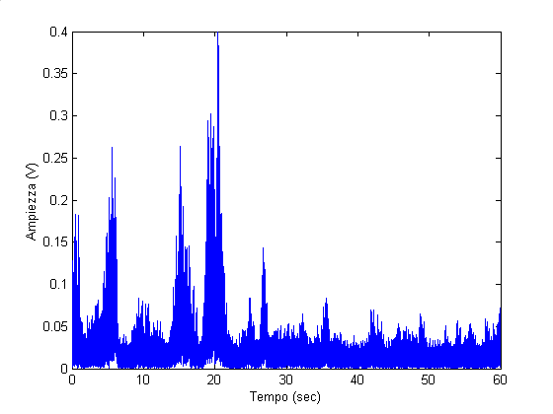
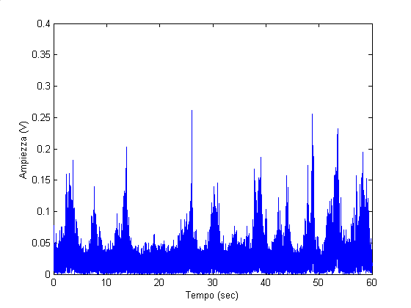
Sea clutter temporal behaviour (30 m)
The spikes have different behaviour in the two like-polarizations (HH and VV)
The vertically polarized returns appear
to be a bit broader but less spiky
The dominant spikes on the HH record persist for about 1-3 s.

Slide 31
Empirically observed models
Empirical studies have produced several candidate models for spiky non-Gaussian clutter, the most popular being the Weibull distribution, the K distribution, the log-normal, the generalized K, the Student-t, etc.
Measured sea clutter data
(IPIX database)
The APDF parameters have been obtained through the Method of Moments (MoM)
the Weibull , K,
log-normal etc. have heavier tails than the Rayleigh

Slide 32
The Gaussian model
The scattered clutter can be written as the vector sum from N random scatterers
phase term
RCS of a single scatterer
With low resolution radars, N is deterministic and very high in each illuminated cell. Through the application of the central limit theorem (CLT) the clutter returns z can be considered as Gaussian distributed, the amplitude r =|z| is Rayleigh distributed and the most important characteristic is the radar cross section.

Slide 33
The compound-Gaussian model
This is not true with high resolution systems. With reduced cell size, the number of scatterers cannot be longer considered constant but random, then improved resolution reduces the average RCS per spatial resolution cell, but it increases the standard deviation of clutter amplitude versus range and cross-range and, in the case of sea clutter, versus time as well.
A modification of the CLT to include random fluctuations of the number N of scatterers can give rise to the K distribution (for APDF):
K distributed if N is a negative binomial r.v. (Gaussian distributed if N is deterministic, Poisson, or binomial)
2-D random walk

Slide 34
The compound-Gaussian model
In general, taking into account the variability of the local power τ, that becomes itself a random variable, we obtain the so-called compound-Gaussian model, then
According to the CG model:
Texture: non negative random process, takes into account the local mean power
Speckle: complex Gaussian process, takes into account the local backscattering

Slide 35
The compound-Gaussian model
Particular cases of CG model (amplitude PDF):
K (Gamma texture)
GK (Generalized Gamma texture)
LNT (log-normal texture)
W, Weibull

Slide 36
The K model
The K model is a special case of the CG model:
N = negative binomial r.v.
τ (local clutter power) = Gamma distributed
Amplitude R = K distributed
Gamma-PDF (texture PDF)
K-PDF (amplitude PDF)
The order parameter ν controls clutter spikiness
The clutter becomes spikier as ν decreases
It becomes Gaussian when ν goes to infinity

Slide 37
The multidimensional CG model
In practice, radars process M pulses at time, thus, to determine the optimal radar processor we need the M-dimensional joint PDF
Since radar clutter is generally highly correlated, the joint PDF cannot be derived by simply taking the product of the marginal PDFs
The appropriate multidimensional non-Gaussian model for use in radar detection studies must incorporate the following features:
1) it must account for the measured first-order statistics (i.e., the APDF should fit the experimental data)
2) it must incorporate pulse-to-pulse correlation between data samples
3) it must be chosen according to some criterion that clearly distinguishes it from the multitude of multidimensional non-Gaussian models, satisfying 1) and 2)

Slide 38
The multidimensional CG model
If the Time-on-Target (ToT) is short, we can consider the texture as constant for the entire ToT, then the compound-Gaussian model degenerates into the spherically invariant random process (SIRP) proposed for modeling the radar sea clutter.
By sampling a SIRP we obtain a spherically invariant random vector (SIRV) whose PDF is given by
where z=[z₁ z₂ . . . z_{M}]^{T} is the M-dimensional complex vector representing the observed data.
A random process that gives rise to such a multidimensional PDF can be physically interpreted in terms of a locally Gaussian process whose power level τ is random.
The PDF of the local power τ is determined by the fluctuation model of the number N of scatterers.

Slide 39
Properties of a SIRV
The PDF of a SIRV is a function of a non negative quadratic form:
A SIRV is a random vector whose PDF is uniquely determined by the specification of a mean vector m_{z}, a covariance matrix M, and a characteristic first-order PDF p_{t}(t):
h_{M}(q) must be positive and monotonically decreasing
First-order amplitude PDF:
A SIRV is invariant under a linear transformation: if z is a SIRV with characteristic PDF p_{τ}(τ), then y=Az+b is a SIRV with the same characteristic PDF p_{τ}(τ).

Slide 40
Properties of a SIRV
Many known APDFs belong to the SIRV family:
Gaussian, Generalized Gaussian, Contaminated normal, Laplace, Generalized Laplace, Chauchy, Generalized Chauchy, K, Student-t, Chi, Generalized Rayleigh, Weibull, Rician, Nakagami-m. The log-normal can not be represented as a SIRV
for some of them p_{t}(t) is not known in closed form
The assumption that, during the time that the m radar pulses are scattered, the number N of scatterers remains fixed, implies that the texture t is constant during the coherent processing interval (CPI), i.e., completely correlated texture
A more general model is given by
Extensions to describe the clutter process (instead of the clutter vector), investigated the cyclostationary properties of the texture process t[n]

Slide 41
Outline of the talk
Introduction
Gaussian model and RCS
Compound-Gaussian model
Spectral modeling
Clutter analysis and model validation
Concluding remarks
EGO Workshop 2012 - October 15-17, 2012 – Cascina

Slide 42
Power Spectral Density (PSD) models
The question is: How to specify the clutter covariance matrix and the power spectral density?
Correct spectral shape impacts clutter cancellation and target detection performance.
The clutter spectrum is not concentrated at zero Doppler only, but spreads at higher frequencies.
There are several reasons for the clutter spreading:
Wind-induced variations of the clutter reflectivity (sea waves, windblown vegetations, etc. ).
Amplitude modulation by the mechanically scanning antenna beam.
Pulse-to-pulse instabilities of the radar system components.
Transmitted frequency drift.
The pulse-to-pulse fluctuation is generally referred to as internal clutter motion (ICM).

Slide 43
PSD models
The PSD is often modeled as having a Gaussian shape:
This is usually a mathematical convenience rather than any attempt at realism. Often the Doppler spectrum will be strongly asymmetric and the mean Doppler shift, m_{f}, may not be zero. Clearly for land clutter m_{f} is usually zero, but for rain and sea clutter in general m_{f} ≠ 0 and will be dependent on the wind speed and direction.
From velocity/Doppler relationship v = f_{D}λ/2,
standard dev. of scatterer velocity is σ_{v} = σ_{f}λ/2
Wind changes bandwidths, but typical σ_{v} are
Rain/chaff σ_{v}~1 to 2 m/s
Sea σ_{v}~1 m/s
Land σ_{v}~0 to 0.5 m/s

Slide 44
PSD models: windblown ground clutter
The Gaussian PSD model was proposed by Barlow [Bar49] for windblown clutter spectra, for noncoherent radar systems and over limited spectral dynamic ranges (up to a level 20 dB below the peak level and to a maximum Doppler velocity of 0.67 m/s)
Essentially all modern measurements of ground clutter spectra, with increased sensitivity compared to those of Barlow, without exception show spectral shapes wider than Barlow’s Gaussian in their tails
It had become theoretically well understood from 1965-67 on, that branch motion in windblown vegetation generates spectra wider than Gaussian
In a much referenced later report, Fishbein et al. [Fis67] introduced the power-law clutter spectral shape:
n is the shape parameter
break-point Doppler frequency where the shape function is 3 dB below its peak zero-Doppler level

Slide 45
PSD models: windblown ground clutter
Common values of power-law exponent n used in PSD modeling are usually on the order of 3 or 4, but sometimes greater
The evidence that clutter spectra have power-law shapes over spectral dynamic ranges reaching 30 to 40 dB below zero-Doppler peaks is essentially empirical, not theoretical.
However, there is no simple physical model or fundamental underlying reason requiring clutter spectral shapes to be power law.
Recently, Billingsley [Bil91] showed that measurements at MIT-LL of windblown ground clutter power spectra to levels substantially lower than most earlier measurements (i.e., 60 to 80 dB below zero-Doppler peaks) indicate spectral shapes that fall off much more rapidly than constant power-law at the lower levels, at rates of decay approaching exponential:
λ is the radar transmission wavelength and β_{e} is the exponential shape parameter

Slide 46
PSD models: windblown ground clutter
Then, recent studies have demonstrated that the ground clutter spectrum of windblown trees consists of three components:
coherent component
slow diffuse component
fast-diffuse component
The coherent component was the results of radar returns from steady objects such as buildings, highways and from movable objects at rest.
The coherent component is at zero Doppler.

Slide 47
Slow-diffuse & fast-diffuse components
The slow-diffuse component is the consequence of motions of objects with moderate inertia (tree branches).
The slow-diffuse component occupies a relative narrow region around zero Doppler.
The spectrum is approximately symmetrical and its spectral density in dB scale decreases linearly with increasing absolute values of Doppler frequency.
The fast-diffuse component is the result of movements in light objects such as a tree leaves. This component has a spectral density similar to a band-limited noise. Its magnitude is usually compared to other components.
The spectral extent is of the same order as the Doppler shifts that corresponds to the wind speed.

Slide 48
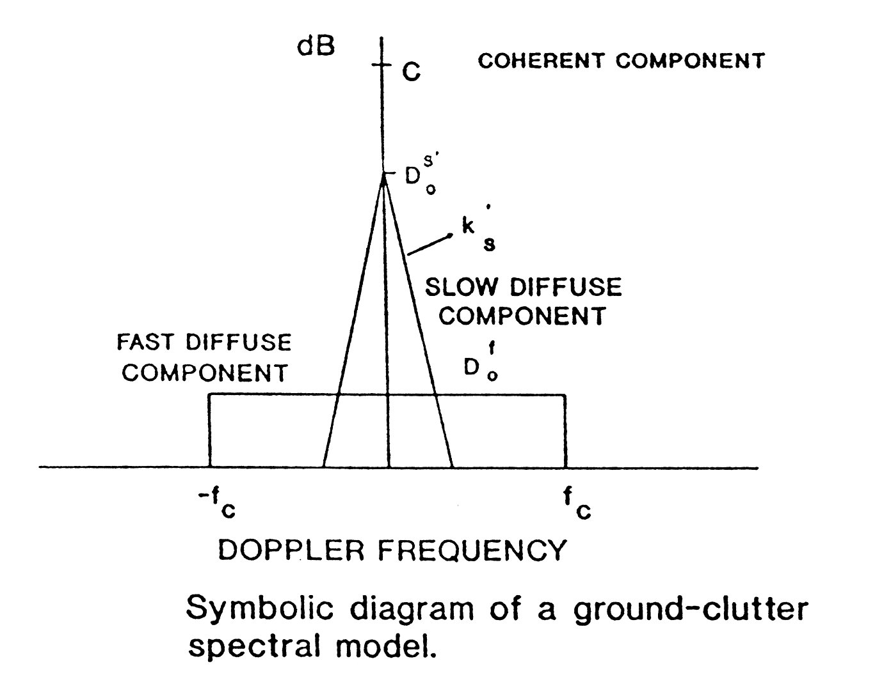
PSD models: windblown ground clutter

Slide 49
PSD models: windblown ground clutter
Spectral shapes having equal AC (Fluctuating) Power - Source: Billingsley (1996)
Each spectrum for wind speed of about 20 mph
The Gaussian shape reported by Barlow (1949)
The power-law shape from Fishbein et al. (1967)
The exponential shape from Billingsley and Larrabee ( 1987)

Slide 50
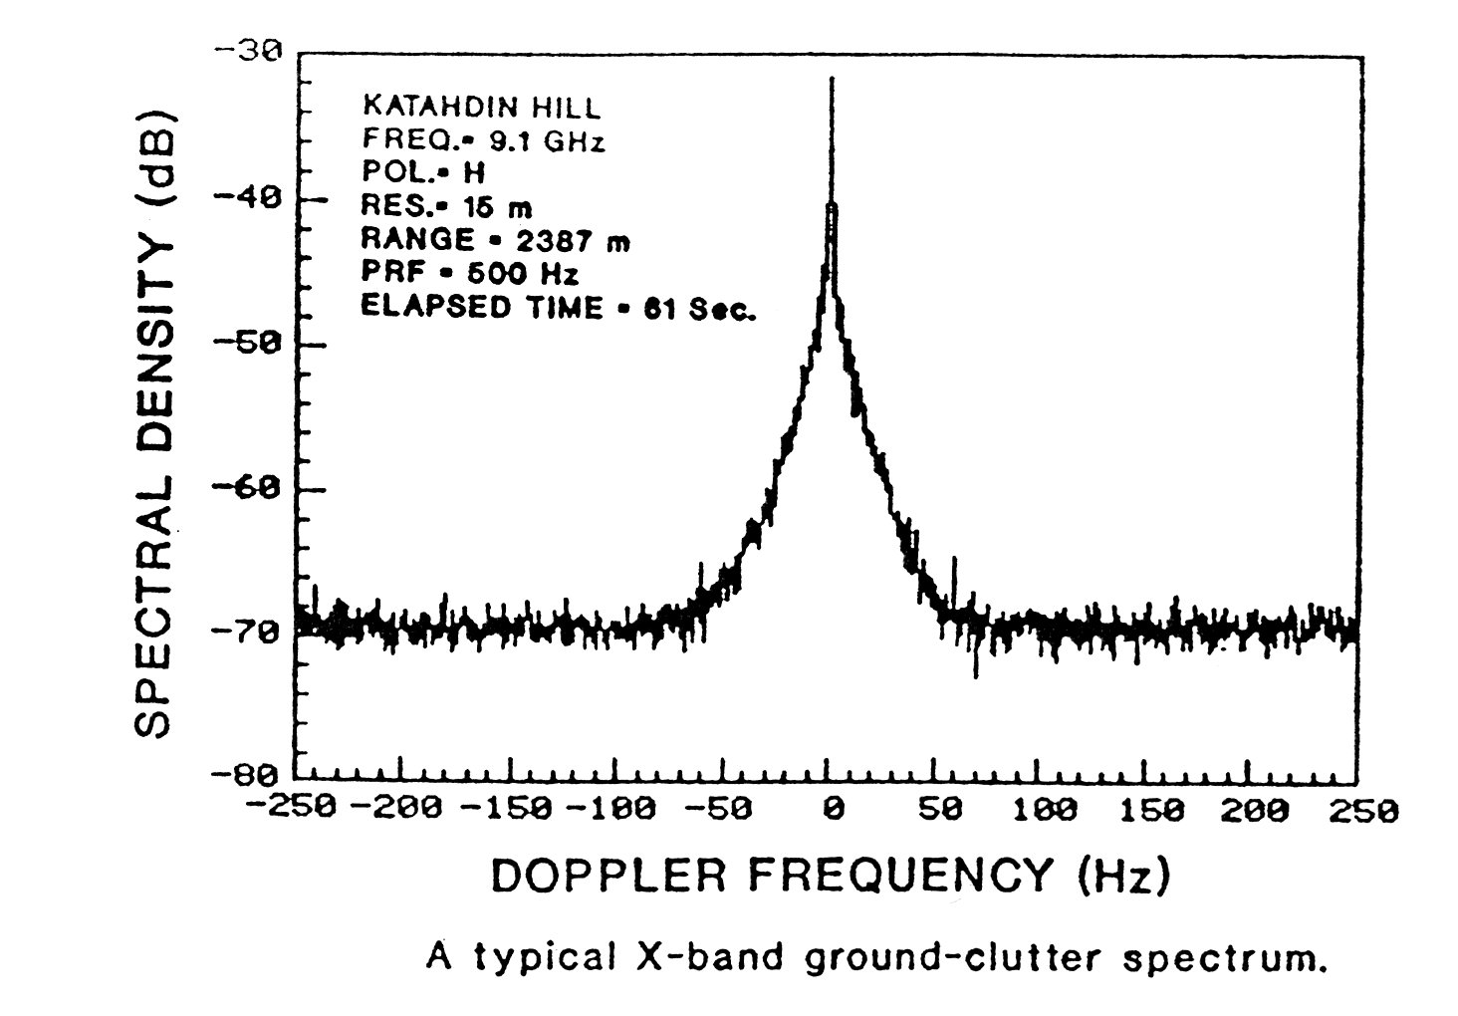
Ground clutter spectra: X-band

Slide 51
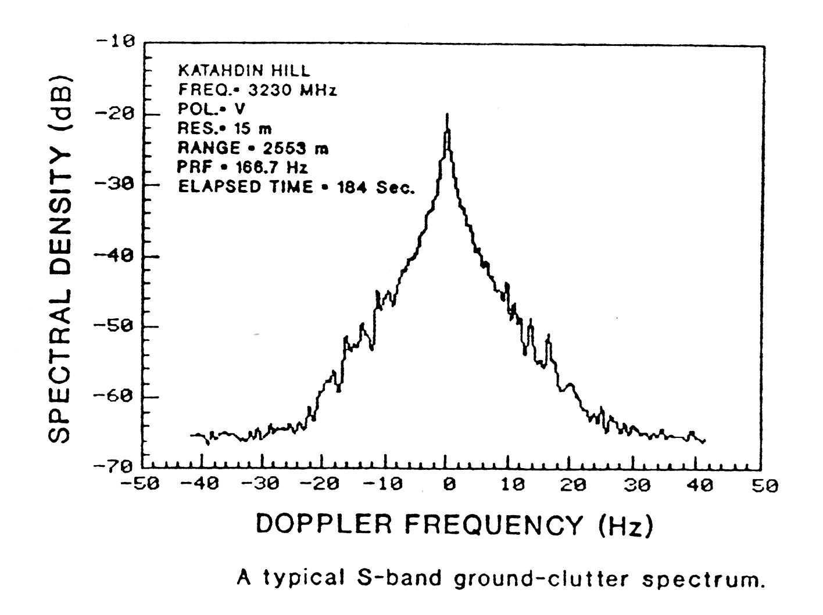
Ground clutter spectra: S-band

Slide 52
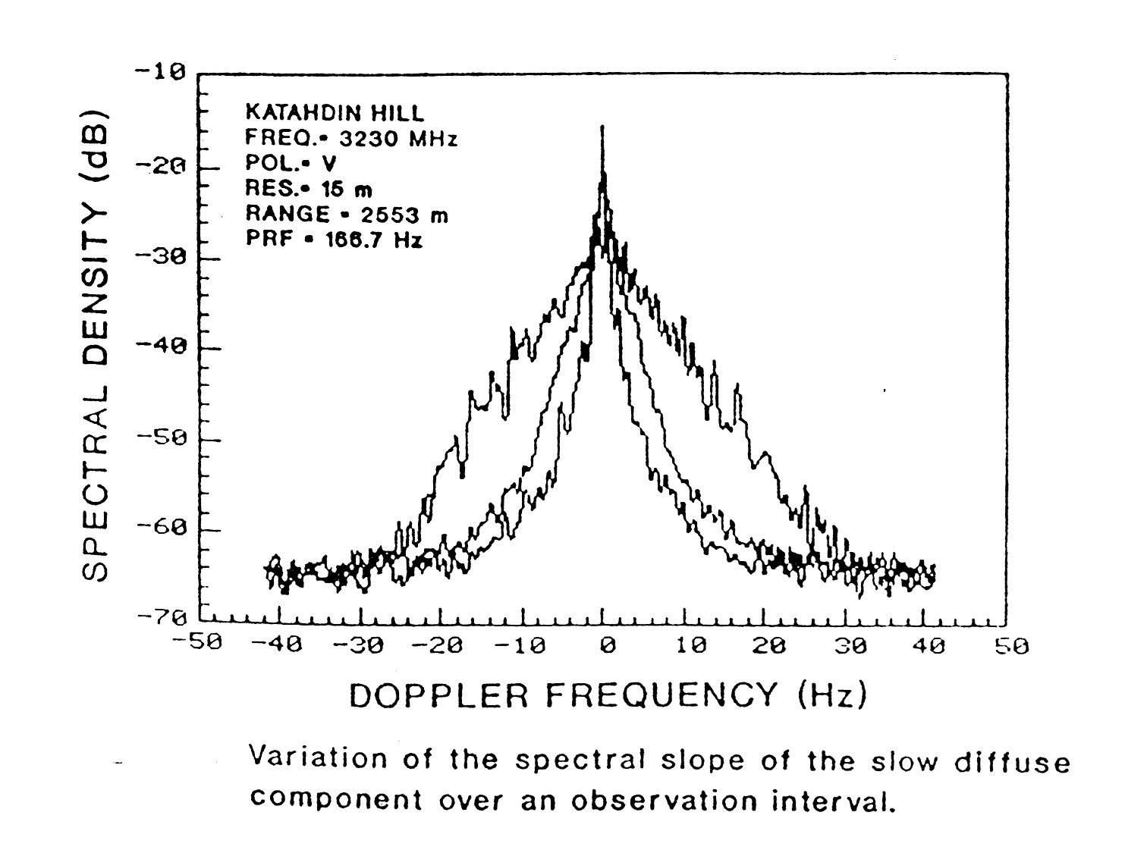
Variation of the spectral slope diffuse components
S-band

Slide 53
L-Band forest PSD vs wind speed
Approximate linear dependence of power density in dB versus velocity, for all wind speeds
For VHF through X band, measured spectral shapes versus Doppler velocity found to be essentially the same
Source: Billingsley (1996).

Slide 54
Sea clutter PSD
The relative motion of the sea surface with respect to the radar causes an intrinsic Doppler shift of the return from individual scatterers.
Because the motion of the scattering elements have varying directions and speeds the total echo contains a spectrum of Doppler frequencies.
Two effects are of interest:
the spectral shape and width
the mean Doppler shift of the entire spectrum.

Slide 55
Sea clutter PSD
The spectrum of sea clutter is sometimes assumed to have Gaussian shape. An approximate relationship between the -3dB bandwidth Δf of the spectrum and sea state S (Douglas scale) has been derived by Nathanson:
The standard deviation of the Gaussian spectrum is related to Δf by the expression:
Recently more complex and realistic models have been proposed for sea clutter PSD. We are going to analyze them later on.

Slide 56
Outline of the talk
Introduction
Gaussian model and RCS
Compound-Gaussian model
Spectral modeling
Clutter analysis and model validation
Concluding remarks
EGO Workshop 2012 - October 15-17, 2012 – Cascina

Slide 57
Model validation: sea clutter data
Amplitude analysis of HH, VV, HV, and VH data
Validation of the compound-Gaussian model by means of speckle and texture analyses
Cumulant domain analysis
Coherent analysis: empirical correlation and PSD
Incoherent analysis: empirical correlation
Conclusions

Slide 58
IPIX Radar Description
Transmitter
• frequency agility (16 frequencies, X-band)
• H and V polarizations, switchable pulse-to-pulse
• pulse width 20 ns to 5000 ns
PRF=0 to 20 KHz
Receiver
• coherent receiver
• 2 linear receivers; H or V on each receiver
quantization: 8 to 10 bits
sample rate: 0 to 50 MHz
BW=5.5 MHz
Antenna
• parabolic dish (2.4 m)
• pencil beam (beamwidth 1.1°)
• grazing angle <1°, fixed or scanning
Source: Defense Research Establishment Ottawa.

Slide 59
Sea clutter temporal behaviour (30 m)
The spikes have different behaviour in the two like-polarizations (HH and VV)
The vertically polarized returns appear
to be a bit broader but less spiky
The dominant spikes on the HH record persist for about 1-3 s.

Slide 60
Average behaviour
EGO Workshop 2012 - October 15-17, 2012 – Cascina

Slide 61
Amplitude statistics
Resolution
Wind direction
EGO Workshop 2012 - October 15-17, 2012 – Cascina

Slide 62

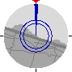

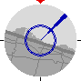
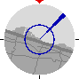
Data Description
Dataset | 19980204_223753 | 19980204_220849 | 19980204_223220
Date and time | 02/04/1998 22:37:53 | 02/04/1998 22:08:49 | 02/04/1998 22:32:20
# Range cells | 28 | 28 | 28
Start range | 3201 m | 3201 m | 3201 m
Range res. | 60 m | 30 m | 15 m
Pulse width | 400 ns | 200 ns | 100 ns
# Sweep | 60000 | 60000 | 60000
Sample per cell | 60000 | 60000 | 60000
PRF | 1 KHz | 1 KHz | 1 KHz
RF-freq. | 9.39 GHz | 9.39 GHz | 9.39 GHz
Radar and wave geometry | S | S | S
19980204_224024 | 19980204_223506
02/04/1998 22:40:24 | 02/04/1998 22:35:06
28 | 27
3201 m | 3201 m
9 m | 3 m
60 ns | 20 ns
60000 | 60000
60000 | 60000
1 KHz | 1 KHz
9.39 GHz | 9.39 GHz
S | S

Slide 63
Statistical Analysis: Amplitude Models
LN, log-normal
W, Weibull
K (Gamma texture)
GK (Generalized Gamma texture)
LNT (log-normal texture)

Slide 64
Statistical Analysis: the CG Model
All, but the log-normal, are particular cases of the compound-Gaussian (CG) model:
Texture: non negative random process, takes into account the local mean power
Speckle: complex Gaussian process, takes into account the local backscattering

Slide 65
Histogram and moments
A histogram is a graphical representation used to plot density of data, and often for density estimation.
A histogram consists of tabular frequencies, shown as adjacent rectangles, erected over discrete intervals (bins), with an area equal to the frequency of the observations in the interval. The height of a rectangle is also equal to the frequency density of the interval, i.e., the frequency divided by the width of the interval. The total area of the histogram is equal to the number of data.
A histogram may also be normalized displaying relative frequencies. In that case the total area is 1. The bins must be adjacent, and often are chosen to be of the same size.

Slide 66
Histogram and moments
K (Gamma texture)
W, Weibull
LN, log-normal
Method of Moments (MoM)
The characteristic parameters of the theoretical PDFs can be estimated by the MoM, which consists of equating experimental moments with the corresponding theoretical moments.
Weibull
Ns number of samples

Slide 67
Statistical Analysis: Results - 15 m
VV data
With resolution of 60 m, 30 m, and 15 m a very good fitting with the GK-PDF.
Negligible differences among polarizations

Slide 68
Statistical Analysis: Results - 3 m
With resolution of 9 m and 3 m histograms with very long tails
Not big differences among polarizations, but generally HH data spikier than VV data
HH data
VV data

Slide 69
Estimated parameters
[Gre06] M. Greco, F. Gini, M. Rangaswamy, “Statistical analysis of measured polarimetric clutter data at different range resolutions,” IEE Proc. Radar, Sonar and Navigation, Vol. 153, No. 6, pp. 473- 481, December 2006

Slide 70
Statistical Analysis: Results - 15 m
IG (Inverse Gamma texture)
Empirical and theoretical PDFs for IPIX recorded data, starea4, range cell #7,
VV polarization

Slide 71
Statistical Analysis: Cumulants
Are the deviations from the compound-Gaussian models due to the thermal noise?
non-Gaussian process
Gaussian process
for k>2
The cumulants of order > 2 show the contribution of the non-Gaussian clutter only.[*]
For compound-Gaussian processes all the cumulants of odd order calculated for are equal to zero.
[*] F. Gini, “A Cumulant-Based Adaptive Technique for Coherent Radar Detection in a Mixture of K-Distributed Clutter and Gaussian Disturbance,” IEEE Trans. on Signal Processing, vol. 45, No. 6, pp. 1507-1519, June 1997.

Slide 72
Statistical Analysis: Cumulants
What are the cumulants? For real processes with zero mean
When, as in our analysis,
It is also useful to define two other parameters:
Skewness
Kurtosis
Both parameters, for Gaussian processes, are zero.

Slide 73
Statistical Analysis: Results
3rd and 5th order cumulants estimated at the origin should be almost equal to zero. True for resolutions up to 9 m.
This is not true for the 5th order cumulant at a resolution of 3 m. The deviations are not only due to the presence of thermal noise.
Range resolution: 3 m

Slide 74
Correlation Analysis: Speckle
Texture correlation
Speckle correlation
Since the texture can be considered constant over short time intervals, we can estimate the speckle autocorrelation functions by using coherent signal samples from such short intervals with or without overlapping
burst #4
burst #3
Nb bursts
burst #2
burst #1
sequence of speckle

Slide 75
Correlation Analysis: Speckle
texture estimator
In all polarizations, the speckle correlation time is about 10 msec long and the behaviour is oscillatory
N=burst length

Slide 76
Correlation Analysis: Texture
Overlap of 50%
Texture covariance
N_{b} = number of samples
60 m
In all polarizations, texture correlation time is some seconds long.
Texture presents periodicity with a period of 8 sec at 60 m and 3 sec at 30 m, particularly in VV data.

Slide 77
Mean Range Texture Autocovariance
N_{b} texture estimates along the time for each range cell
cell #1
Variations of the texture along the range.
cell #2
We want to estimate now the correlation along the range.
cell # N_{c}

Slide 78
Mean Range Texture Autocovariance
With a resolution of 3 m it is possible to resolve shorter range periodicities that are not visible in the other resolutions.
VV data
HH data

Slide 79
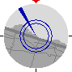
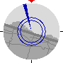
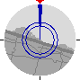
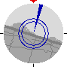
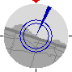

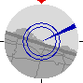
Wind direction dependence
-30˚ -15˚ 0˚ 15˚ 30˚ 45˚ 60˚
Angle (degrees)
Resolution of 30 m.
Mean value of the estimated Weibull shape parameter C.
There is not a noticeable behaviour as a function of angle.

Slide 80
Conclusions on the amplitude statistics
With range resolutions up to 15 m, good fitting with GK-PDF in all polarizations.
At 9 m and 3 m the Gaussian-compound models fails in many cells.
HH data are almost always spikier than VV and VH-HV data.
The average speckle correlation time is 10 msec.
The average texture correlation time is some seconds long.
Texture covariance presents (time) periodicities with a period of 8 sec at 60 m and 3 sec at 30 m. Increasing the resolution the periodicities disappear due to the strong contribution of thermal noise.

Slide 81
Average spectral models
EGO Workshop 2012 - October 15-17, 2012 – Cascina

Slide 82
Sea clutter average spectra
Capillary waves with wavelengths on the order of centimetres or less. Generated by turbulent gusts of near surface wind; their restoring force is the surface tension.
Longer gravity waves (sea or swell) with wavelengths ranging from a few hundred meters to less than a meter. Swells are produced by stable winds and their restoring force is the force of gravity.

Slide 83
Sea clutter average spectra
In the literature, it has been often assumed that the sea clutter has Lorentzian spectrum (i.e., autoregressive of order 1).
Autoregressive (AR) models with the order P ranging from 2 to 5 have also been proposed for modelling radar clutter.
For the sea surfaces some experimental analysis at small grazing angle, C and X-bands, indicate that the sea Doppler spectrum cannot be expressed by the Bragg mechanism only, but also by wave bunching (super-events).

Slide 84
Sea clutter average spectra
Lee et al. showed that the spectral lineshapes can be decomposed into three basis functions which are Lorentzian, Gaussian, and Voigtian (convolution of the Gaussian and Lorentzian):
peak of the Lorentzian function
= characteristic scatterer lifetime
shape parameter
f_{V} = centre of the Voigt function

Slide 85
How to estimate the clutter PSD
The PSD can be estimated parametrically (or model-based) or non-parametrically, without any hypothesis on the model.
Non parametrically, we used the periodogram defined as:
where is the Fourier Transform of the data and M the number of samples.
There are many variants of the periodogram (for instance, method of Welch, Blackman and Tukey) [see e.g. Stoica and Moses book on Power Spectral Analysis].

Slide 86
How to estimate the clutter PSD
The parametric methods can depend on the adopted models, but generally their aim is to estimate the characteristic parameters of the model itself. This leads to a need of a lower number of data for the estimation and to better performance of the PSD estimators.
For the case at hand of Lorentzian, Gaussian and Voigtian models, we used a Non-Linear Least-Square (NLLS) Method as follows
where is the vector of parameters that must be estimated,
is the theoretical model and is the periodogram.
Results

Slide 87
Sea clutter average spectra
The spectrum is the sum of two basis functions among: the Gaussian, the Lorentzian, and the Voigtian, with different Doppler peaks.
HH polarization
non-par: periodogram
Gauss and Voigtian basis functions
VV polarization
High peak (Voigtian): 450 Hz
Low peak (Gaussian): 320 Hz
High peak (Voigtian): 410 Hz
Low peak: (Gaussian): 250 Hz

Slide 88
AR modelling
An Autoregressive process of order P, AR(P), is characterized by the difference equation:
where the coefficients are the process parameters, and W(n) is white noise
For estimating the AR(P) parameters, we use the Yule-Walker equations
In our case, we don’t know the “true” correlation of the clutter, so we estimate it as

Slide 89
AR modelling
We replace the estimated correlation to the true one and we solve the linear system
so obtaining an estimate of the characteristic parameters of the PSD.
We tried AR(P) with P=1 up to 16.
AR(3) model shows good fitting with data and seems to capture physical phenomena.
Good compromise between model complexity and fitting accuracy.
Example of periodogram calculated on 60,000 HH polarized data.

Slide 90
Wind direction dependence
-30˚ -15˚ 0˚ 15˚ 30˚ 45˚ 60˚
Angle (degrees)
Doppler peak position

Slide 91
NON-STATIONARITY ANALYSIS
EGO Workshop 2012 - October 15-17, 2012 – Cascina

Slide 92
Scattering phenomena
Bragg scattering, present in both HH and VV data, but stronger in VV data.
Whitecaps scattering; the amplitude of both like-polarizations are roughly equal and are noticeably stronger than the background scatter, particularly in HH, in which the Bragg scattering is often weak.
Spikes, absent in VV data and strong only in up-wind HH data.

Slide 93
Sea clutter: stationary or non-stationary process?
Large-scale and small-scale components
Bragg waves: C₀
Bragg scattering: the return signals from scatterers with wavelength λ_{B} reinforce each other since they are in phase
Wind drift: D_{w}
Long waves: V_{OR}
Current: V_{C}
Large-scale structure changes the distance between the antenna and the patch, tilts and advects the small-scale structure
C₀ phase velocity of Bragg waves
V_{OR} orbital velocity: periodic
D_{w} wind drift
V_{c} current velocity

Slide 94
Long wave modulation
spectrogram
normalized spectrogram
changes in speckle frequency content
Frequency modulation
texture (power) changes
Amplitude modulation

Slide 95
Long wave modulation: Hybrid AM/FM model
estimated texture
estimated Doppler centroid
where
estimated bandwidth
Texture, centroid and bandwidth show about the same periodicity

Slide 96
Long wave modulation: Hybrid AM/FM model
Estimated cross-correlation between texture and Doppler centroid
where
Very similar to cross-correlation between sinusoidal signals with a common period of about 10 s, separated by a time lag of 2.5 s

Slide 97
Long wave modulation: Hybrid AM/FM model
Near line-shape Doppler spectra.
Principal component located in correspondence of the long wave frequency f_{LW}=0.1 Hz.
Secondary components often located at f=2 f_{LW}.

Slide 98
Long wave modulation: Hybrid AM/FM model
For higher resolutions (9 and 3 m) the effect of the noise is not negligible. The estimated parameters relate to the noise and not to the clutter. The periodicities tend to disappear
Shorter periodicity with higher resolution: the period is 4-5 sec long

Slide 99
AR modelling
AR(3) model shows good fitting with data and seems to capture physical phenomena.
Good compromise between model complexity and fitting accuracy.
Periodogram calculated on VV polarized data

Slide 100
AR modelling
AR(3) estimated Doppler centroid
where
AR power spectral density
AR(3) estimated bandwidth
Again
texture, centroid and bandwidth show same periodicity

Slide 101
AR modelling
Comparison between parameters non-parametrically and parametrically estimated by AR modelling
Good fitting of the non-stationary
AR(3) model

Slide 102
AR modelling
The frequency of 1st pole is periodic as the texture
The frequency of 2nd pole is almost constant when the texture is maximum and noisy elsewhere

Slide 103
Remarks (more details in [**])
Long waves modulate in amplitude and in frequency small-scale structure scattering.
Texture, Doppler centroid and bandwidth show same periodicity as long waves: texture and speckle are not independent.
Non-stationary AR(3) modelling shows good fitting with data and seems to capture physical phenomena.
[**] M. Greco, F. Gini, “Sea clutter non-stationarity: the influence of long-waves”, Chap. 5 of Adaptive radar signal processing, Simon Haykin editor, John Wiley & Sons, Inc., Hoboken, New Jersey, 2007.

Slide 104
Ground clutter data
EGO Workshop 2012 - October 15-17, 2012 – Cascina

Slide 105
Ground clutter data analysis
Measurement instrumentation
Analysis of I and Q clutter components
Azimuth and range spectral analysis
Amplitude PDF analysis
Modified KS test
[Bil99] J.B.Billingsley, A.Farina, F.Gini, M. Greco, L.Verrazzani "Statistical Analyses of Measured Radar Ground Clutter Data," IEEE Trans. on AES, Vol. 35, No. 2, pp.579-593, April 1999.
[Gre01] M. Greco, F. Gini, A. Farina, and J. B. Billingsley, “Validation of Windblown Radar Ground Clutter Spectral Shape,” IEEE Trans. on AES, Vol. 37, No. 2, pp.538-548, April 2001.
[Lom01] P. Lombardo, M. Greco, F. Gini, A. Farina, J.B. Billingsley, “Impact of Clutter Spectra on Radar Performance Prediction”, IEEE Trans. on AES, Vol. 37, No. 3, pp.1022-1038, July 2001.

Slide 106
Data recorded at Wolseley site with MIT-LL Phase One radar
PHASE ONE radar parameters
Source: MIT-LL, courtesy Mr. J. B. Billingsley
• Frequency Band (MHz) VHF UHF L-Band S-Band X-Band
165 435 1230 3240 9200
• PRF 500 Hz
• Polarization (TX/RX) VV or HH
•Range Resolution 150, 36, 15 m
•Azimuth Resolution 13° 5° 3° 1° 1°
•Peak Power 10 KW (50 KW at X-Band)
•Antenna Control Step or Scan through Azimuth Sector
•Tower Height 60´ or 100´
•10 Km Sensitivity -60 dB
•Amount of Data 25 Tapes/Site
•Acquisition Time 2 Weeks/Site

Slide 107
X-band ground clutter data in open agricultural terrain
703
The illuminated area was covered by agricultural crops (83%), deciduous trees (11%), lakes (4%), and rural farm buildings (2%).
azimuth
2D clutter map
1
1
range
3D clutter map
316
VV polarization
Black areas: high reflectivity
(buildings, fencelines, trees, bushes aligned along roads)
White areas: low reflectivity
(field surfaces)

Slide 108
Ground clutter data analysis: agricultural terrain
Skewness
Kurtosis
Analysis of I and Q clutter components
Skewness = degree of asymmetry
Kurtosis = relative peakedness or flatness
for Gaussian clutter: Skewness=0, Kurtosis=0

Slide 109
Ground clutter data analysis
The analysis, performed on each range interval has shown that I and Q PDFs deviate considerably from Gaussian:
the clutter amplitude is not Rayleigh distributed
The phase is uniformly distributed
(it may be not for DC offset, quantization effects, etc.)

Slide 110
Agricultural terrain : azimuth correlation analysis
Correlation properties may have a significant effect on the performance of processing algorithms aimed at suppressing clutter for signal detection, especially in terms of false alarm rate (FAR) behavior.
Clutter samples decorrelate to 0.29 in one 1°-beamwidth, to ~ 0 in four beamwidths.

Slide 111
Agricultural terrain : azimuth spectral analysis
The scanning motion of the antenna results in relative radial velocities of the clutter scatterers with respect to the antenna.
The spectral broadening shown in the figure is due to the antenna radial motion.
Knowledge of spectral spreading due to intrinsic clutter motion (ICM) is important for quantifying MTI performance against small targets.
The AR(3) model was derived by the overdetermined Yule-Walker method.
The spectral content largely falls within 2 Hz (i.e. + 1 Hz ), which matches the decorrelation time (~ 0.5 s)

Slide 112
Agricultural terrain : range correlation analysis
The two decorrelation times (in range and in azimuth) are quite different:
Along the azimuth direction the coefficient reduces to 0.1 in a few seconds.
Along the range, we have the same decreasing in few hundreds of nanoseconds.
These apparently large differences are mostly due to the different time-sampling frequencies utilized in range (10 MHz) and in azimuth (15.625 Hz).
We calculated the correlation for each azimuth cell, and then we averaged the 703 estimates

Slide 113
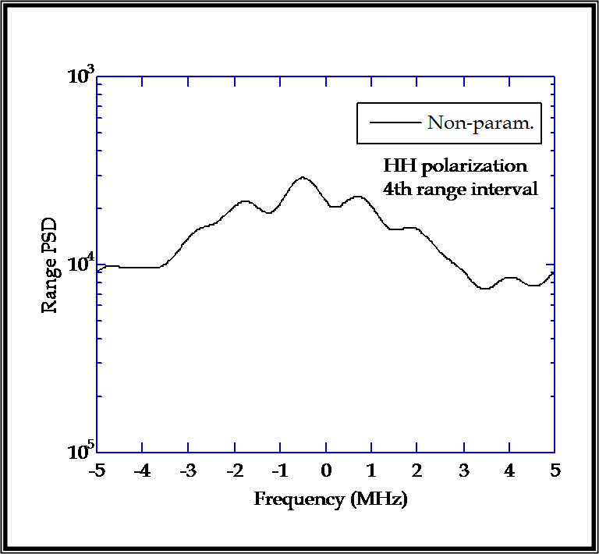
Ground clutter: range spectral analysis
The range PSD is almost flat.
The correlation time of ~100 ns (~ one pulse length). provides frequency content over the complete Nyquist frequency range.
The assumption usually made in adaptive radar detection of independence of the data from different range cells seems to be reasonable in the Wolseley data.
Owing to the heterogeneity of the spatial scattering ensemble in open farmland terrain (strong discrete sources dispersed over a weakly scattering medium), the returned signal from the scanning antenna largely decorrelates from one spatial cell to the next, whether the variation is in the range direction or in the azimuth direction.

Slide 114
Ground clutter data analysis
Amplitude PDF analysis: we estimated normalized
moments defined as

Slide 115
Ground clutter data analysis
1st and 2nd range intervals:
the Weibull distribution provides the best fitting
3rd and 4th range intervals:
the data show a behaviour that is intermediate between Weibull and log-normal

Slide 116
Weibull paper (Boothe diagram)
The fitting is good for the 1st and the 2nd range intervals, for HH and VV data.
3rd and 4th range intervals: a non negligible deviation is present for small values of X.
This deviation is due to the presence of thermal noise corruption at low signal levels.

Slide 117
The KS goodness-of-fit test
The Kolmogorov–Smirnov test (KS test) is a nonparametric test for the equality of continuous, one-dimensional probability distributions.
Can be used to compare a sample with a reference probability distribution (one-sample KS test), or to compare two samples (two-sample KS test).
The KS statistic quantifies a distance between the empirical distribution function F_{n}(x) of the sample and the cumulative distribution function of the reference distribution F(x), or between the empirical distribution functions of two samples.
where sup(.) is the supremum of the set of distances.

Slide 118
The KS goodness-of-fit test
If F is continuous then under the null hypothesis H₀ (the empirical distribution and the reference one are equal) converges to the Kolmogorov distribution, which does not depend on F.
The goodness-of-fit test or the Kolmogorov–Smirnov test is constructed by using the critical values of the Kolmogorov distribution. The null hypothesis is rejected at level a if
where K_{a} is found from
a is also known as probability of type I error. It represents the probability of making a mistake rejecting the null hypothesis under H₀ .

Slide 119
The modified KS goodness-of-fit test
In practical radar applications a good fit is important in the tail regions of the PDFs.The tails, in fact, contain the strong values (i.e., the spikes) that, considered as target returns by the detector, can increase the false alarm rate (FAR).
Standard two-sample KS test: we obtained a probability of type I error always <1%, for all the distributions (Rayleigh, log-normal, Weibull, and K). Thus, in the classical formulation, the KS test is useless for our purposes.
Since good fitting in the tails is mandatory for correct design of CFAR processors, especially when low P_{FA} values are required, the KS test is of limited use for clutter data.
The idea is simple: apply the standard KS test by taking into account only the tail regions, i.e., by considering only the data above a given threshold.

Slide 120
Ground clutter data analysis: windblown vegetation
Analyzed clutter data: - recorded at Katahdin Hill site by Lincoln Laboratory.
- Phase One X-band stationary antenna.
- HH-polarization, PRF=500 Hz, 76 range gates.
3D power map
Number of pulse repetition time intervals
Range cells
Data set courtesy of Barrie Billingsley
of MIT – Lincoln Laboratory
These data are Gaussian.

Slide 121
Spectral model on windblown vegetation
PSD, 35th range cell.
Cell #35 | Exp | Gauss | PL2 | PL3
β/σ/f_{c}/f_{c} | 5.95 (Hz m)⁻¹ | 23.63 Hz | 1.02 Hz | 6.33 Hz
Non-Linear Least Squares (NLLS) method is used for parameter estimation:

Slide 122
Outline of the talk
Introduction
Gaussian model and RCS
Compound-Gaussian model
Spectral modeling
Clutter analysis and model validation
Concluding remarks
EGO Workshop 2012 - October 15-17, 2012 – Cascina

Slide 123
Concluding Remarks
High resolution sea and ground clutter is generally non-Gaussian
Good fitting of compound-Gaussian model
K and IG model for the sea
Weibull for the land
AR and exponential spectral models
Non-stationarity

Slide 124
Thanks for your attention
QUESTIONS?

